Slide 1
TEAM PEDS
Himanshi Manglunia
Kalpita Raut
Ann Laura Walker

Slide 2
Introduction
IPEDS : Integrated Postsecondary Education Data System.
System of interrelated surveys conducted annually
Gathers information from every college, university, vocational and technical institutions that participate in the federal student financial aid program

Slide 3
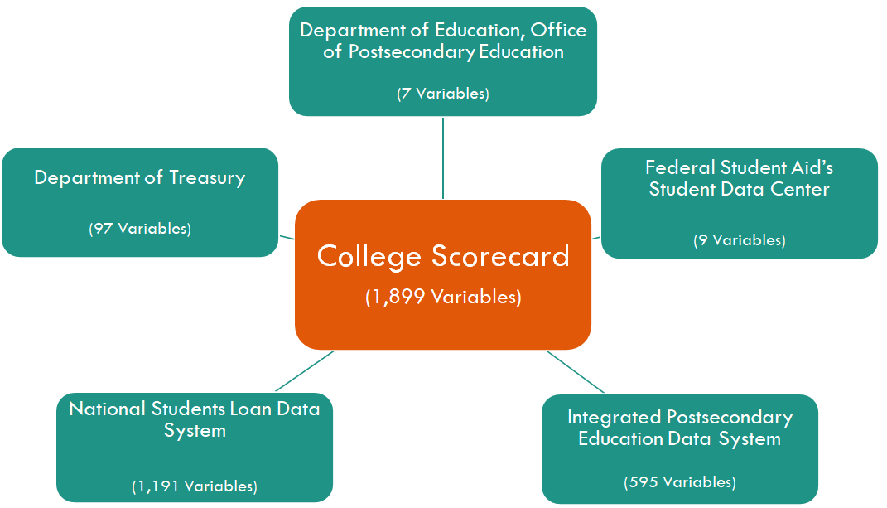
Sources of Information

Slide 4
About the Dataset
IPEDS data consist of 3 modules:
Institutional characteristics
Admissions Fall, Graduation Rates, Student Financial aid
Fall enrollment, Finance Human Resource components and Academic Libraries
Per its data dictionary, is made up of approximately 1,800 variables +
broken down into categories ranging from:
Admissions | Aid | Completion
Tuition | Loan Repayments | Earnings Post Graduation

Slide 5
Data Preparation & Cleaning
Combined the 5 years data which was distributed in 5 datasets into a single dataset, by adding a column year into the final one using R.
There were separate columns for several attributes for Male and Female categories, those were combined and values added to a new column called Gender.
Removed the missing values using the data using rodbc package in R.

Slide 6
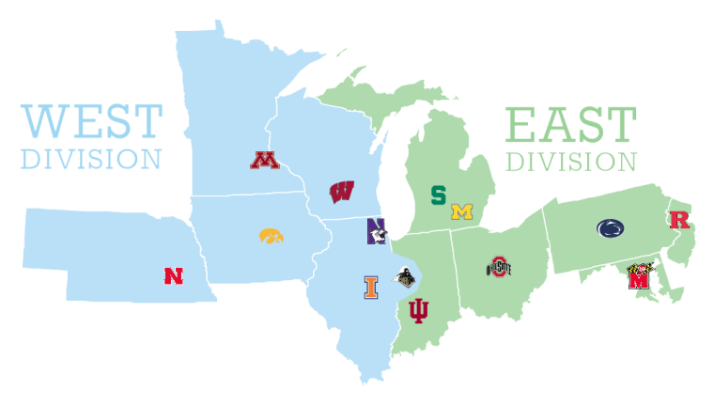
Big Ten Institutions: Who are they?
9.8 billion in funded research
100,000 full-time graduates
400,000 full-time undergraduates
Notes:
https://brand.iu.edu/design/logos-lockups/index.html
https://brand.uiowa.edu/university-logo
https://ucomm.unl.edu/toolbox/our-marks

Slide 7
Target Audience
Prospective international students hoping to come to the United States to study
Media companies like US News that publish rankings and analysis for the public
University Staff that focuses on Financial Aid

Slide 8
Question
How does University of Maryland compare with the other BIG TEN institutions based on :
Debt/Earnings
Repayment
Completion

Slide 9
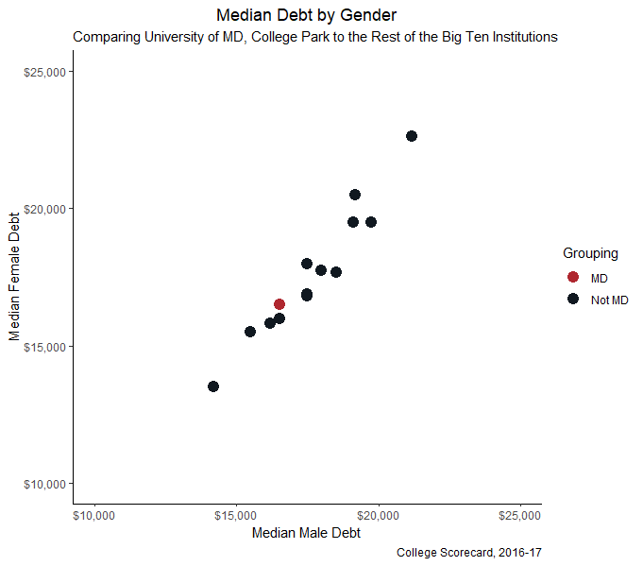
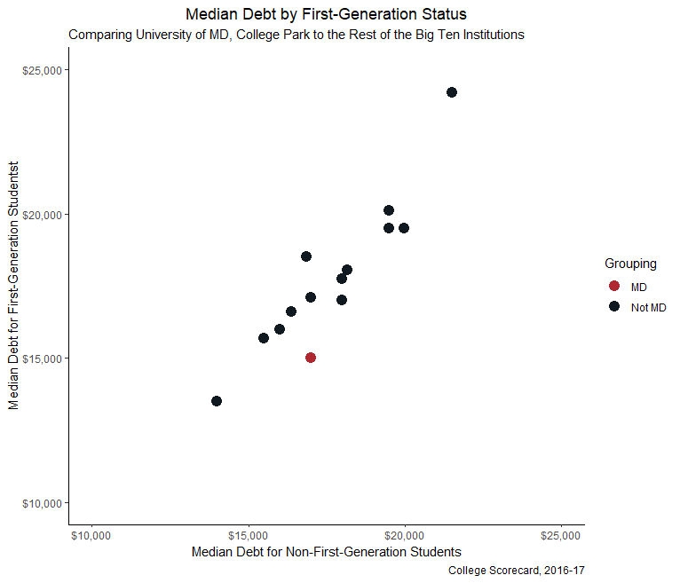
Category: Debt
Trends tend to remain the same between both analyses
More of a positive disparity between First-Generation and Non-First-Generation students with College Park

Slide 10
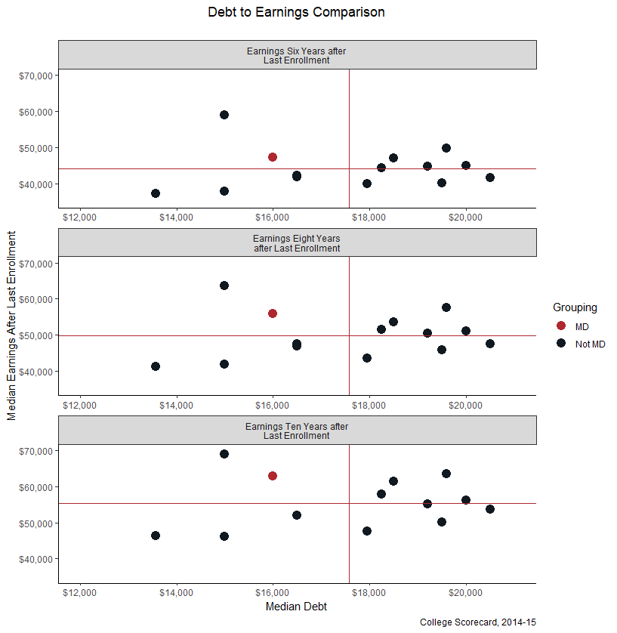
Category: Debt & Earnings
Compares the level of debt former students have with their earnings.
Red lines indicate means.
Students from College Park are below the Big Ten average for the level of debt AND
Tend to be above the average of earnings.
Limitations:
Latest data were from 2014-15

Slide 11
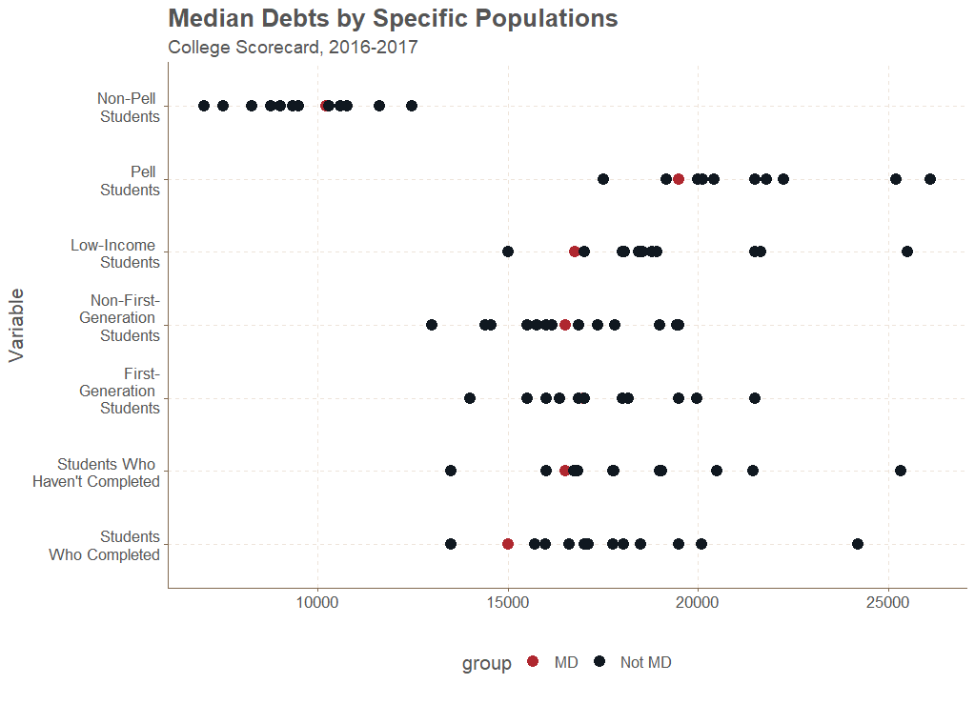
Category: Debt
Students from College Park tend to be at or below the average for many of these populations.
Point of Concern: The level of debt for Pell Students

Slide 12
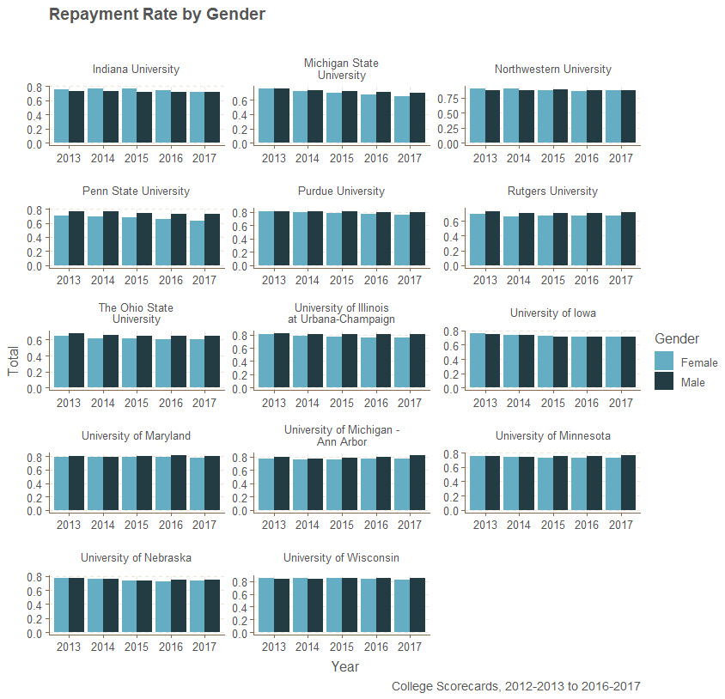
Category:Repayment
There seems to be more of a discrepancy between genders at other institutions like Penn and Ohio State.
College Park seems to be more steady both in terms of:
Rates of repayments
Differences between genders

Slide 13
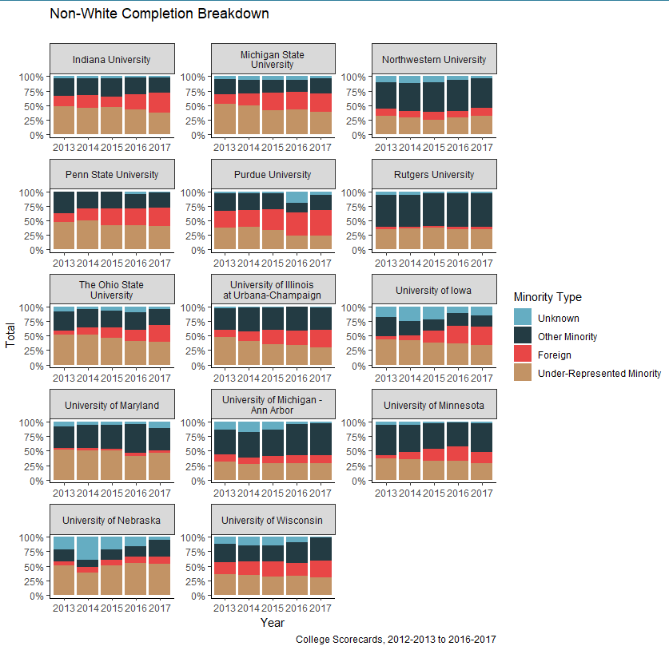
Category: Completions
Many institutions experiencing decreases in underrepresented minorities, as seen nationally.
2016 sees the maximum completion rate for “Foreign minorities” as well as “Other minorities”
Completion rate for “Unknown” minorities is seen as decreasing from 2013 to 2016, and there is a slight increase in 2017.
National trends seem to indicate a decrease in minority attendance and completions

Slide 14
Conclusions
Students may feel that UMD is an expensive school, and they may not be able to afford it, so they think twice before applying.
But as we can see from our analysis,
The repayment rate is high among the Big Ten institutions
Debt to Earnings ratio is low, which means the students pay their debt using their earnings in full within a reason.
Completion rates high when compared to Big Ten
Through this analysis, we can say that the return on investment (ROI) for UMD is high.

Slide 15

Questions?

